Slide 1


Notes:
Respected Professors and my peers,
I wish to present to you, The Eye. A new club under the Computer Science and Engineering Association with a focus on Cyber Security. Our goals include high-level tasks like spreading awareness as well as low-level in-depth tasks like developing Security Intelligence Software and Tools.
Our tagline is “Visio Protectoris” – which means “The Vision of the Protectors” in Latin.

Slide 2

GOALS OF THE CLUB
Notes:
I will be taking a few minutes of your time to present to you the goals of our newly founded club, as well as introduce the office bearers of the newly founded club.

Slide 3

CYBERSECURITY
Research Papers | Projects | Workshops
Learning the common Vulnerabilities, how its carried out, and how to protect the system from those vulnerabilities Regular meets to discuss latest vulnerabilities and how to prevent them. CTF Sessions to improve/test cybersecurity skills | Phishing detection system Secure IOT device framework | Linux and SQL Fundamentals Workshop Cybersecurity Networking Workshop
GOALS OF THE CLUB
Notes:
The goals of the club are four.
Events – We plan to conduct 2-3 events for the academic year of 2022-2023, which can be of 2 types. Capture The Flag Contests, which are essentially hackathons, featuring attractive rewards and prizes, and Workshops in order to spread awareness on Cybersecurity and inculcate the Cybersecurity culture in our college.
Whitepapers – We plan to release on our website whitepapers of 3 types – Research Papers on new fields in Cybersecurity, Case Studies on Security Incidents like the recent Uber Hack where Uber was hacked by an employee of it’s own, and Safety Guideline documents for the common public involving topics like Guidelines on using Email Safely, Guidelines on staying safe from Phishing, etc.
Intelligence Development – This involves developing tools and programs to assist in Security Research Operations to help secure infrastructure.
Bug Bounty Research – This involves performing Security Research Operations on entities that provide Responsible Vulnerability Disclosure programmes in order to help secure infrastructure.

Slide 4
ARTIFICIAL INTELLIGENCE
Research Papers | Projects | Workshops
Discussing about the newest AI trends in the industry learning and discovering new techniques for AI (libraries, implementations) Creating use case based models for different purposes discussed and studying effectiveness of the model. (Eg: modeling traffic flow and trying to improve the efficiency of the same) | A.I Data Security Project A.I Image Processing Project A.I-based Automated IDS | What is AI:Workshop Implementation of AI through python
GOALS OF THE CLUB
Notes:
The goals of the club are four.
Events – We plan to conduct 2-3 events for the academic year of 2022-2023, which can be of 2 types. Capture The Flag Contests, which are essentially hackathons, featuring attractive rewards and prizes, and Workshops in order to spread awareness on Cybersecurity and inculcate the Cybersecurity culture in our college.
Whitepapers – We plan to release on our website whitepapers of 3 types – Research Papers on new fields in Cybersecurity, Case Studies on Security Incidents like the recent Uber Hack where Uber was hacked by an employee of it’s own, and Safety Guideline documents for the common public involving topics like Guidelines on using Email Safely, Guidelines on staying safe from Phishing, etc.
Intelligence Development – This involves developing tools and programs to assist in Security Research Operations to help secure infrastructure.
Bug Bounty Research – This involves performing Security Research Operations on entities that provide Responsible Vulnerability Disclosure programmes in order to help secure infrastructure.

Slide 5
WEB DEVELOPMENT
Research Papers | Projects | Workshops
Learning the newest frameworks used in the industry. Experimenting new design languages Creating templates for future websites. Working on increments to The Eye’s official Website Studying database design and different implementations | Website Redesign Project Internal Website Project | Framework based Workshop UI/UX Workshop
GOALS OF THE CLUB
Notes:
The goals of the club are four.
Events – We plan to conduct 2-3 events for the academic year of 2022-2023, which can be of 2 types. Capture The Flag Contests, which are essentially hackathons, featuring attractive rewards and prizes, and Workshops in order to spread awareness on Cybersecurity and inculcate the Cybersecurity culture in our college.
Whitepapers – We plan to release on our website whitepapers of 3 types – Research Papers on new fields in Cybersecurity, Case Studies on Security Incidents like the recent Uber Hack where Uber was hacked by an employee of it’s own, and Safety Guideline documents for the common public involving topics like Guidelines on using Email Safely, Guidelines on staying safe from Phishing, etc.
Intelligence Development – This involves developing tools and programs to assist in Security Research Operations to help secure infrastructure.
Bug Bounty Research – This involves performing Security Research Operations on entities that provide Responsible Vulnerability Disclosure programmes in order to help secure infrastructure.

Slide 6

OFFICE BEARERS
Notes:
Now, I wish to present to you the 9 office bearers of our newly founded club.

Slide 7

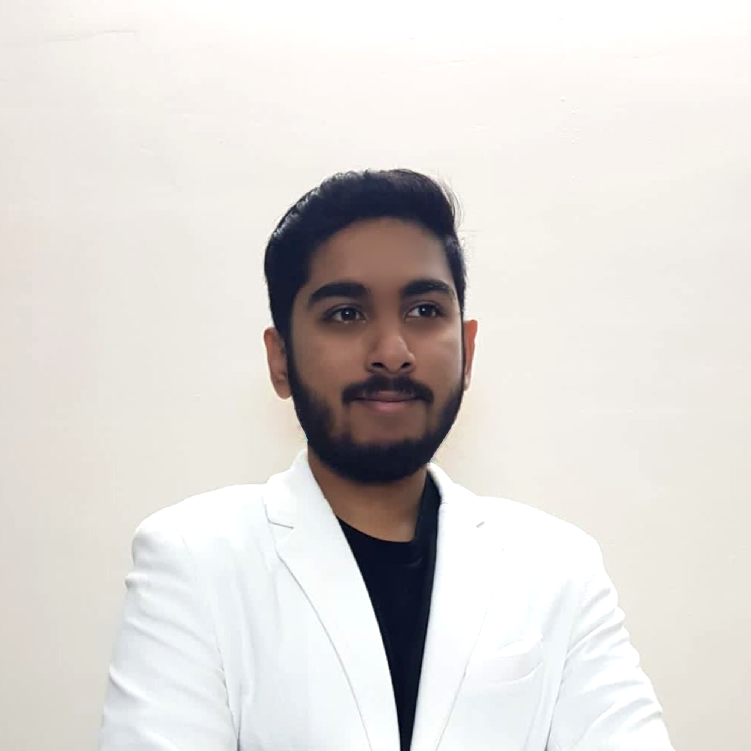

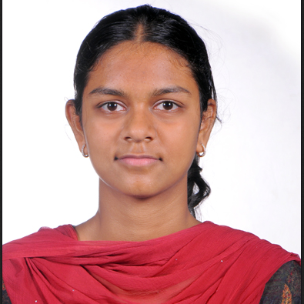
Aaditya Rengarajan
Founding Member
Club Head 2023-2024
National Security Database Certified Penetration Tester
Certified Ethical Hacker
Student at PSG College of Technology
Amithalakshmi Raj
Club Head 2023-2024
Notes:
Let us start with myself, the founding member of this club. I am Aaditya Rengarajan, am a student of BE CSE G1 of 2nd Year. I work with the National Security Database, which is endorsed by the Government of India, in order to secure the national cyber-assets, and have also received recognition from the Government of India and the Government of Kuwait for carrying out ethical hacking operations. I also work with Tactical Cyberange Simulations and ISAC (Information Sharing and Analysis Center), developing mission-critical security testing software. I am currently undergoing the Certified Ethical Hacker course by EC Council, and will be completing it by the end of this year.

Slide 8

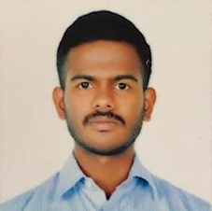
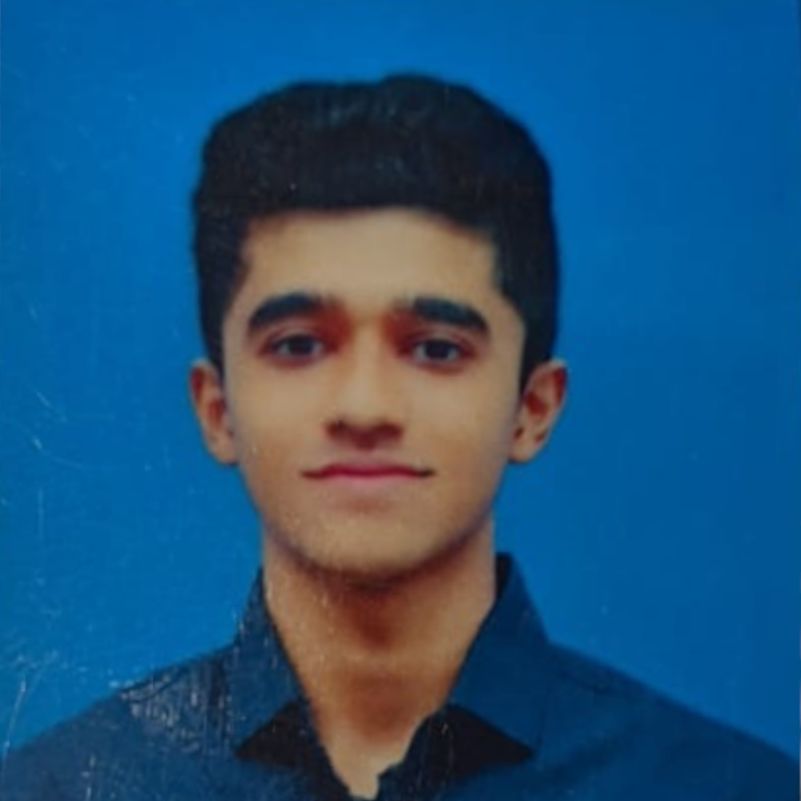
STUDENT ADVISORS
Dhanush Gowdhaman
(20Z214)
Soorya Subramani
(21Z258)

Slide 9

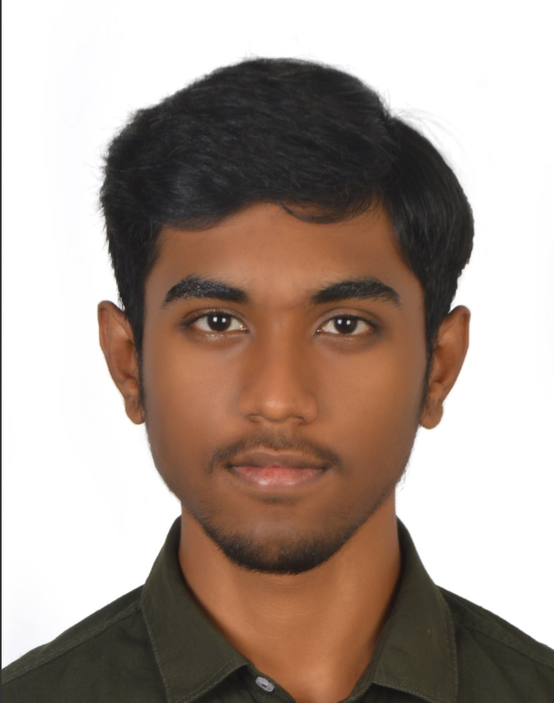
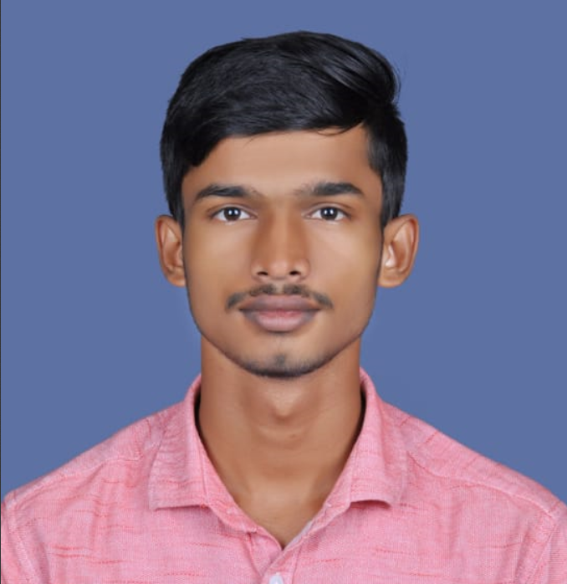
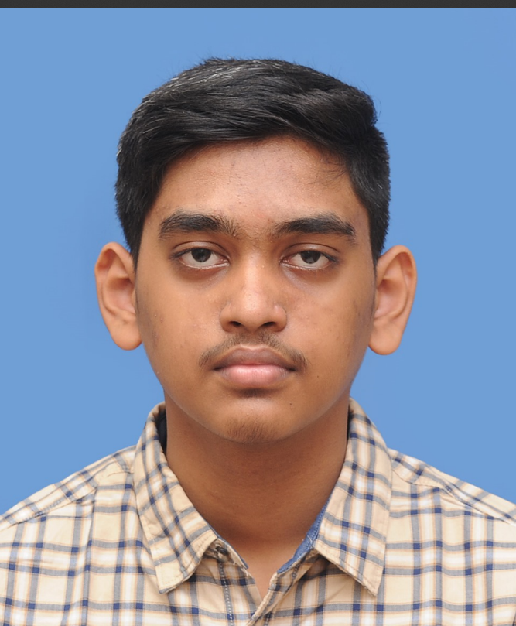
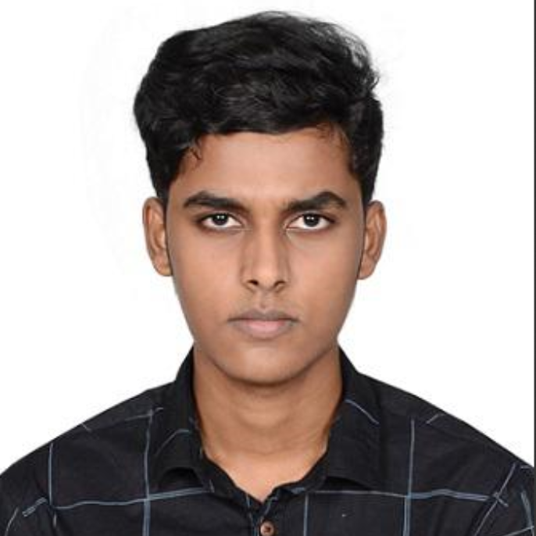
Arun U. S.
Manojkumar K.
TECHNICAL
TEAM
Lohith S.
Udith Aakash

Slide 10
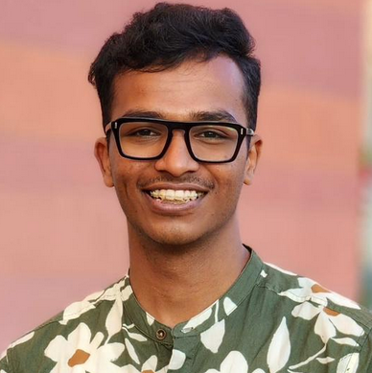
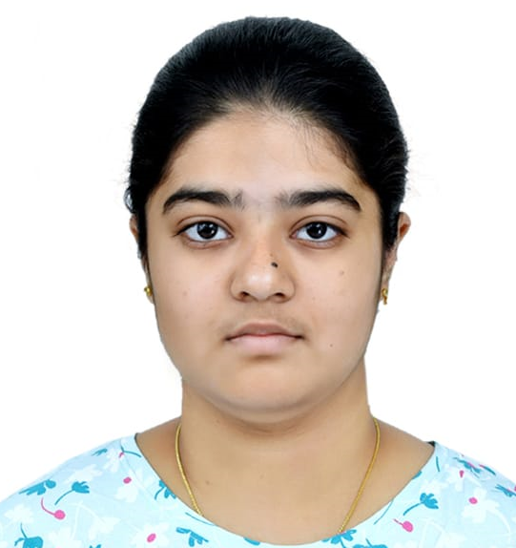
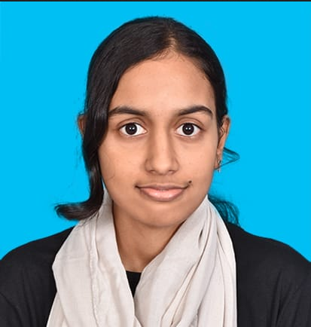
EVENTS
MANAGEMENT
Richard Samuel
Abinaya Suresh
Harini M.

Slide 11
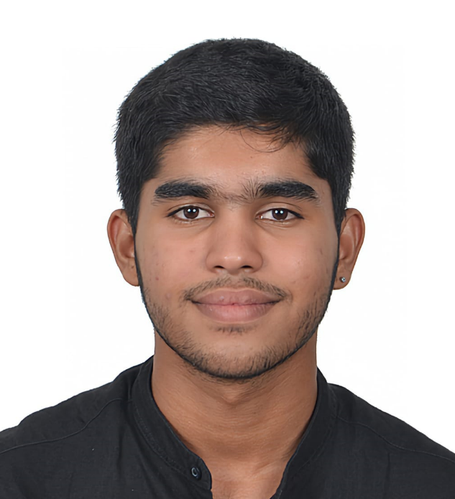
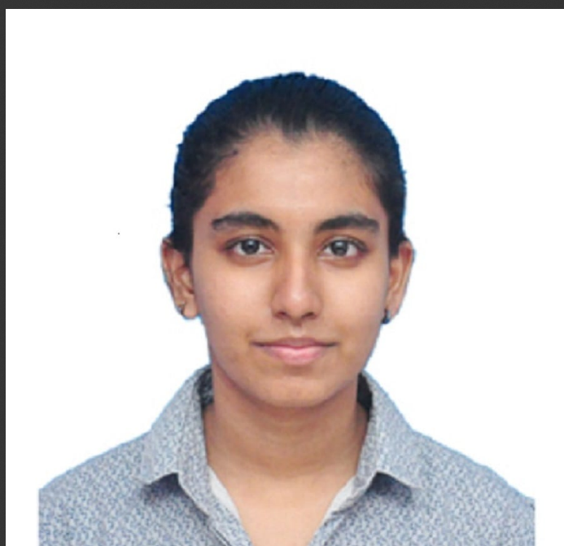
Mehul Dhinesh
Keerthi O.
PUBLICITY AND PR

Slide 12
PLANNED EVENTS
October 7, 2023: INTRAMS
EVENT
November 20, 2023: Prompt Battle
EVENT
Even Semester, 2024: Jeopardy
EVENT
Even Semester, 2024: Pitch Day
EVENT
Notes:
I will be taking a few minutes of your time to present to you the goals of our newly founded club, as well as introduce the office bearers of the newly founded club.

